Slide 1
Celebral Watch Tumor Monitoring
2105343_Aarnab Dutta
2105346_Abhiskek Ranjan
2105816_Ravi Raj Shrivastava
21051164_Sai Sanket Bal
21051732_Shivam Singh
2105339 _Vinnamala Sai Sujith

Slide 2
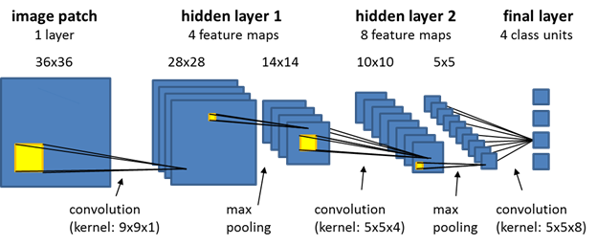
Techniques and Technologies Used
The Convolutional Neural Network (CNN or ConvNet) is a subtype of Neural Networks that is mainly used for computer vision tasks such as image recognition, object detection with common use cases including facial recognition and medical image analysis.
Its built-in convolutional layer reduces the high dimensionality of images without losing its information. That is why CNNs are especially suited for this case.

Slide 3
What is Transfer Learning
Transfer learning in deep learning refers to the technique of using a model that has been pre-trained on a large dataset, and then fine-tuning that model on a smaller, task-specific dataset.
The key idea behind transfer learning is to leverage the knowledge and feature representations learned by the pre-trained model to improve the performance on the new task, often with a smaller dataset
Transfer learning is widely used in various deep learning applications, such as image recognition, natural language processing, and speech recognition to improve model performance.

Slide 4
Why Transfer Learning
Improved Performance: The pre-trained model has already learned useful low-level features, which can significantly improve performance on the new task, especially when the new dataset is small.
Faster Convergence: The training process converges more quickly compared to training a model from scratch, as the network has already learned relevant features.
Reduced Training Data Requirement: Transfer learning can achieve good performance with smaller datasets, which is particularly useful when the new task has limited data available.

Slide 5
VGG -19
The VGG19 model (also known as VGGNet-19) has the same basic idea as the VGG16 model, with the exception that it supports 19 layers. The numbers “16” and “19” refer to the model’s weight layers (convolutional layers). In comparison to VGG16, VGG19 contains three extra convolutional layers.
Why VGG - 19
Depth: VGG-19 has 19 trainable layers, consisting of 16 convolutional layers, 5 max-pooling layers, and 3 fully connected layers.
Small Convolution Filters: The convolutional layers in VGG-19 use small 3x3 convolution filters, which are stacked to increase the depth of the network and the receptive field.
Simplicity: VGG-19 has a relatively simple and uniform architecture, which makes it easy to implement and understand which includes high performance, ease of use and implementation

Slide 6
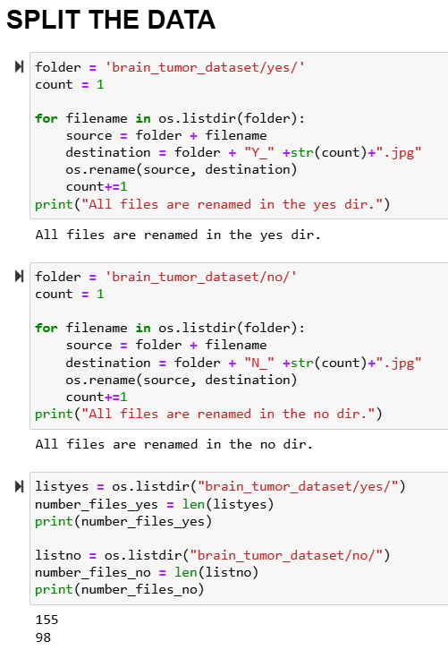
Split The Data
The code renames images in the "yes" (tumorous) and "no" (non-tumorous) folders by adding unique prefixes ("Y_" and "N_") for easier identification and organization It then counts the images in each category and displays a bar chart comparing the number of tumorous and non-tumorous images to visualize the dataset's distribution. The data is then organized into a dictionary and used to plot a bar chart comparing the number of tumorous vs. non-tumorous images.

Slide 7
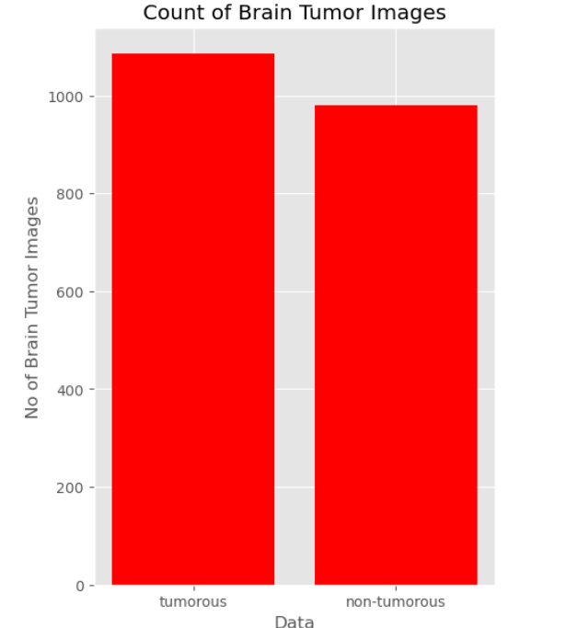
Data Augementation
generates augmented images from a brain tumor dataset using transformations like rotation, brightness adjustment, flipping, and shifting to increase the number of samples for better training A summary of the augmented dataset is calculated, showing a total of 2,065 images: 1,085 tumorous (52.54%) and 980 non-tumorous (47.46%). A bar chart visually compares the number of tumorous and non-tumorous images for quick insights into data distribution

Slide 8
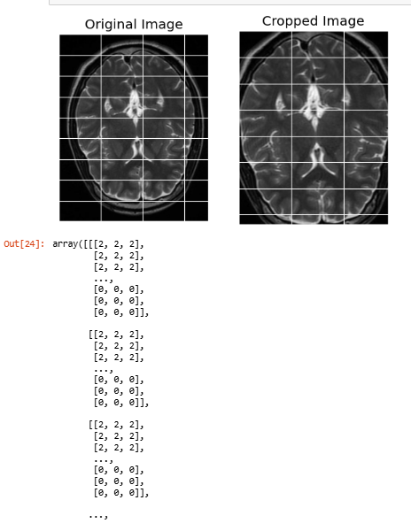
Data PreProcessing
This code crops brain tumor images by isolating the region of interest (ROI) using contour detection, focusing on the tumor area for better analysis and accuracy.
It processes each image by converting it to grayscale, applying Gaussian blur, and using binary thresholding to highlight the tumor boundaries before cropping.
The cropped images are saved back to their respective folders, improving dataset quality, and can be optionally visualized with side-by-side comparisons of the original and cropped images.

Slide 9
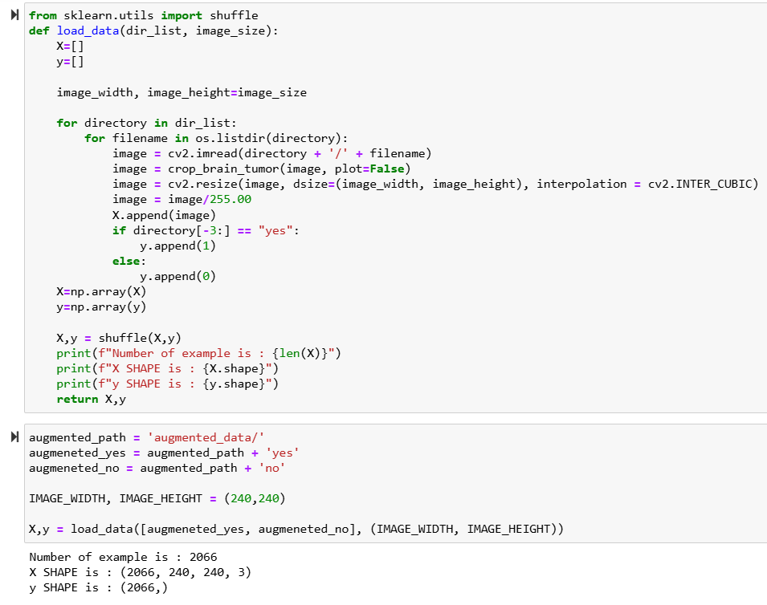
Image Loading
Data Loading and Preprocessing: This code loads brain tumor images from "yes" (tumorous) and "no" (non-tumorous) directories, resizes them to a specified size (240x240), normalizes pixel values, and labels them (1 for "yes," 0 for "no"). Shuffling for Randomization: The images and their corresponding labels are shuffled to ensure a balanced and unbiased dataset for training machine learning models. Visualization of Samples: It plots a grid of sample images, displaying 50 examples from each category ("Yes" or "No") to visually inspect the dataset's quality and distribution.

Slide 10
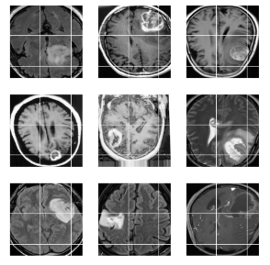
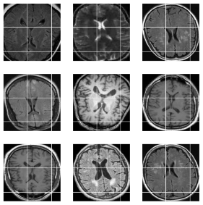
Tumorous & NonTumorous

Slide 11
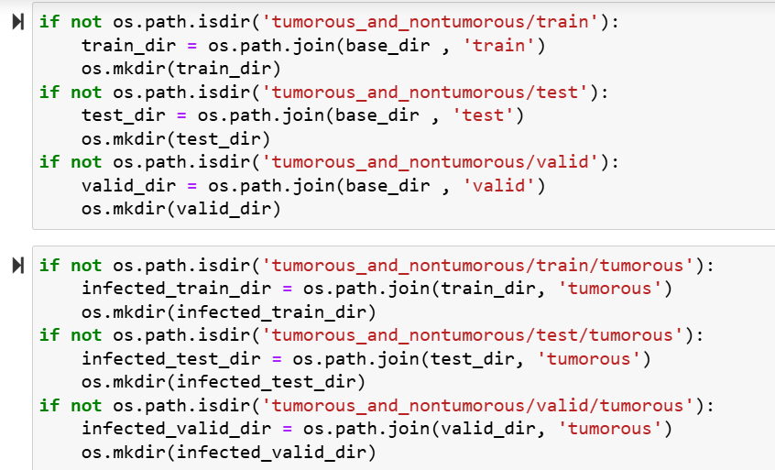
Data Splitting (Training Testing and Validation)
Directory Creation for Dataset Organization: The code creates a structured directory system (train, test, and valid) under a main folder tumorous_and_nontumorous to organize the dataset into training, testing, and validation subsets. Data Splitting and Copying: It divides the images from the "augmented_data" directory (tumorous and non-tumorous) into specified portions for training, testing, and validation, ensuring each set has distinct files. Dataset Preparation for Model Training: The organized dataset ensures proper data management, enabling efficient training, testing, and validation of machine learning models for brain tumor classification.

Slide 12
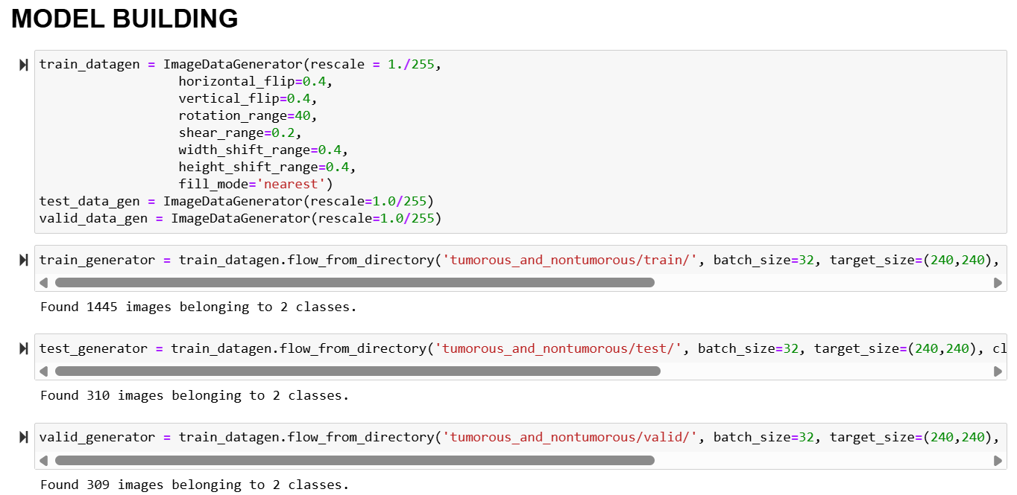
Model Building
Model Building with Transfer Learning: It leverages the pre-trained VGG19 model as the base, adds custom layers for classification, and sets the output to predict two classes (tumorous and non-tumorous), using categorical_crossentropy as the loss function. Training and Optimization: The model is compiled with the SGD optimizer, and callbacks like EarlyStopping, ModelCheckpoint, and ReduceLROnPlateau are used to improve training efficiency, prevent overfitting, and save the best model during the training process.

Slide 13
Model Building
Training Performance Visualization: The code plots the model's training and validation accuracy and loss across epochs, providing a clear view of the model's performance improvement during training. It highlights how well the model generalizes to unseen data. Model Evaluation and Saving: The trained model is evaluated on both the validation and test datasets to obtain accuracy and loss metrics. The model's weights are saved for future use to avoid retraining. Prediction on Test Data: The model makes predictions on the test dataset, and the predicted class labels are obtained by selecting the class with the highest probability from the output.

Slide 14
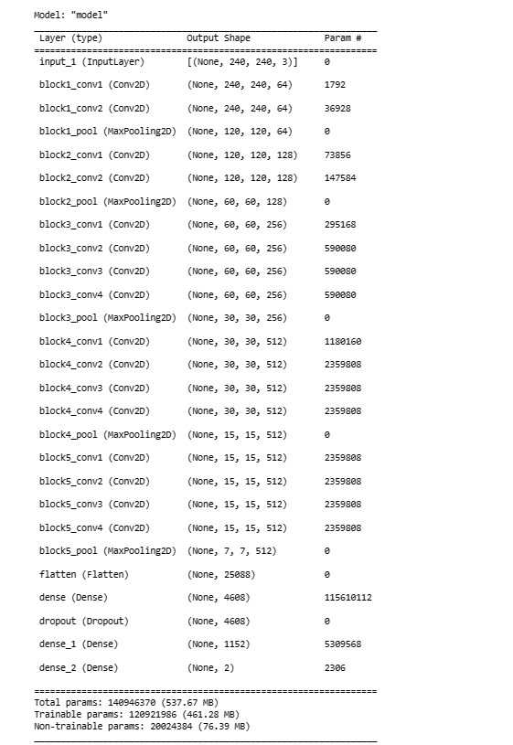
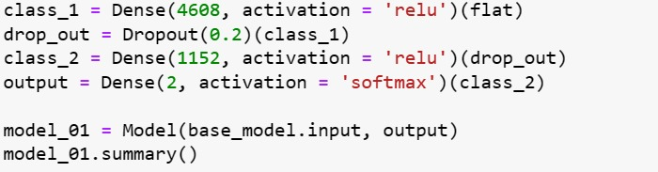
Load the VGG 19 model, pretrained on ImageNet
Model Summary
Create a new model that includes the VGG 19 base model and additional layers for classification

Slide 15
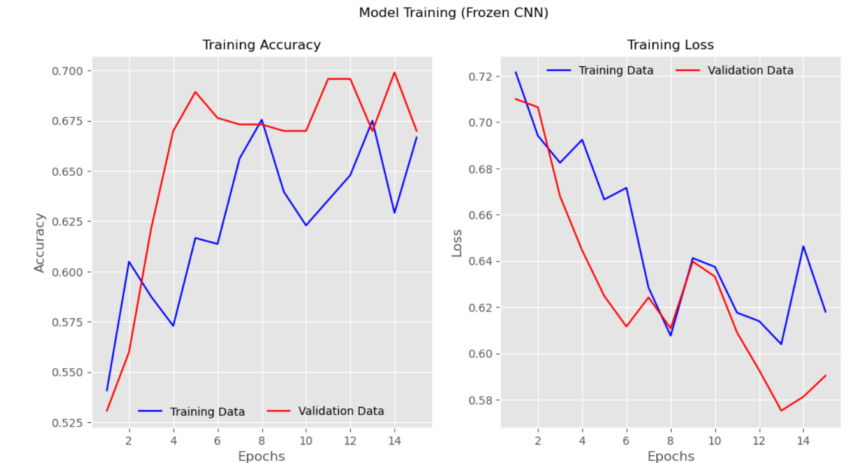
Plot Perfomance
we visualized the model's performance using plots for metrics such as accuracy, loss, precision, and recall over training and validation datasets. These plots helped us analyze if the model was overfitting, underfitting, or performing optimally.The accuracy and loss were tracked across epochs to measure model performance. Training accuracy reached 70% by the 15th epoch, with validation metrics showing minimal overfitting

Slide 16
Evaluating the Best Model
Model Compilation and Training: The model is compiled using the legacy SGD optimizer with a low learning rate and momentum and is trained on the dataset for a set number of epochs. The training process involves calculating the loss and accuracy for both the training and validation sets. Plotting Training Metrics: During the training process, the accuracy and loss values are plotted for both the training and validation sets over epochs. This helps visualize the model’s learning process, showing how well it generalizes to unseen data and whether it's overfitting or improving. Model Evaluation and Saving: After training, the model is evaluated on both validation and test datasets to assess its performance. The model weights are saved to a file for later use, allowing the trained model to be reused without retraining.

Slide 17
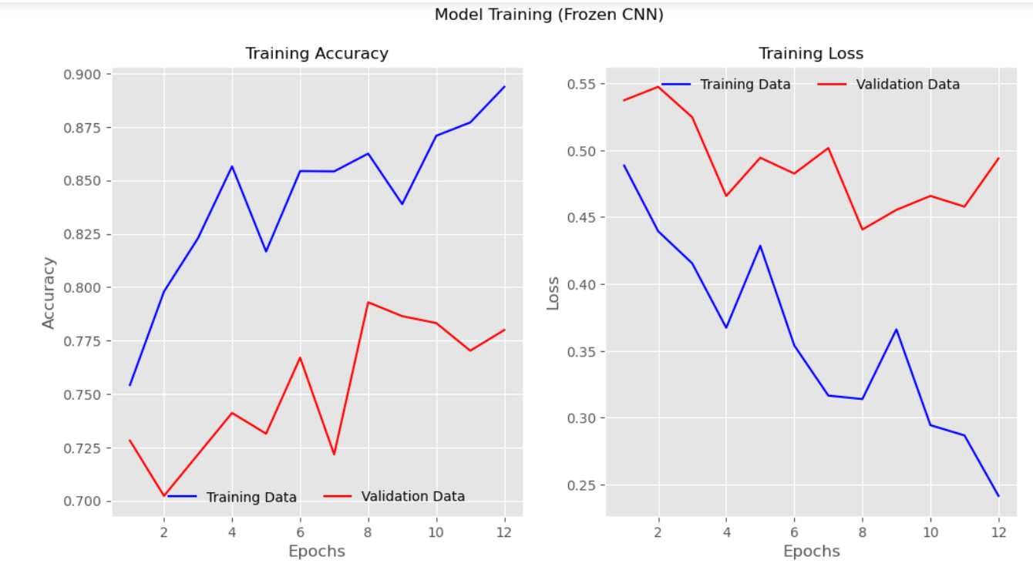
Plot Perfomance of the Best Model
The model at the 15th iteration has almost an accuracy of 90%

Slide 18
Deployment
The developed Brain Tumor Detection system was deployed using the python Flask integrated model with React web app, allowing for easy integration and accessibility. Users can upload MRI scans through a web interface, and the system provides real-time predictions regarding the presence of tumors.
The deployed system demonstrated promising performance in detecting brain tumors, achieving high accuracy and robustness in real-world scenarios. The model's ability to accurately classify tumor and non-tumor images signifies its potential as a valuable diagnostic tool for healthcare professionals.

Slide 19
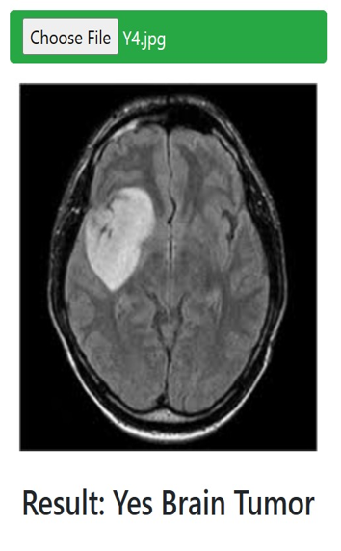
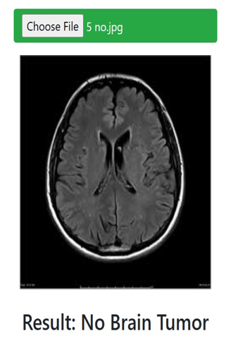
Final Output

